Slide 2
Presentation Outline
WiFiMon: Introduction & Problem Statement
WiFiMon: Data Flow & Overall Architecture
Data Collection Technology: Crowdsourced & HW Probe Measurements
TNC19 Pilot & Indicative Results
Feedback from TNC19 & 6th SIG-PMV Meeting Audience
Revision & Changes in WiFiMon – Feedback Integration
Future Work
Notes:
Mobile Crowd Sensing System: An example and how Wifimon could proceed
WCsPM: Discuss several points to understand WiFiMon functionality (i) Concept Overview, (ii) Process, (iii) Architecture Building blocks, (iv) walk through (Data Flow Diagram), (v) GUI screenshots
Mobile application measurement: (i) Architecture, (ii) Mobile Measurements process
Hybrid Approach: (i) Prerequisites, (ii) Setup procedure
WiFiMon Security & Privacy: Beyond WCsPMV – eduroam SP and IdP policy/Process/
Results discussions End-User Meeting in Zurich (May 2017)

Slide 3
WiFiMon: Introduction
Mission Statement:
“…Is it possible to gather data from multiple sources, including browser-based measurements, in addition to traditional monitoring, and extract meaningful information on the performance of a WiFi network from that data?…”
Notes:
Generic statement:
Gather data from multiple sources,
Browser based measurement in addition to traditional monitoring
Extract Data: Accurate enough so that we can propagate a “Performance statement for a WiFi campus”
So we figured out a problem statement…

Slide 4
WiFiMon - Problem statement
Measuring and verifying the performance of WiFi networks is challenging.
There are no tools that:
Cover all aspects of performance monitoring and verification.
Determine how end-users experience WiFi at a given place on the network,
at a given time.
At present, information for wireless networks can be reported in three ways:
Mobile End-User Device
Wireless Access Points (WAP) / WiFi-Controller
Network Management Systems (NMS)
These sources allow “only” determining the wireless network is overall OK,
e.g. up/down
HW probes collect performance measurements but are installed at fixed locations. Crowdsourced measurements are also required.

Slide 5
WiFiMon - Data Flow
Real Time Analysis:
- Performance Data Parsing
Correlation of Performance Data with Accounting Data
Mobility Prediction (Future Work)
- Focus: Network Performance
- Focus: # Users Prediction
PERFORMANCE DATA
ANALYZE DATA
IEEE802.1X / eduroam enabled infrastructures:
- End-users: Smartphones, Laptops - Hardware Probes
Filtered RADIUS
Logs
Correlation Results
ACCOUNTING DATA
STORE DATA
CONSUME & VISUALIZE DATA
RADIUS Logs:
- Data Filtering (Logstash)
Data Storage (Elasticsearch) - Filtered RADIUS Logs - Correlated Results: Performance Data correlated with RADIUS Logs
WiFiMon GUI:
- Visualization (Kibana)
- User Options
5
Notes:
The aim of our approach is to record network performance measurements by using collected raw data (data source) on WiFi and to visualize them. ==========
Temporary Data – Raw data from the data source
Persistent Data – Correlated data
==========
Only correlated data will be stored and analysed
Mobility prediction and focus is possible, so the correlation with the AP helps us to provide a localized statement to the network performance.
==========
The Web-User Interface is the Network Administrators view, about their own data. In our concept use Kibana (for visualization) and Elasticsearch (as a DB).
It is worth mentioning that previous WiFiMon versions used Grafana/InfluxDB and PostGresql

Slide 6
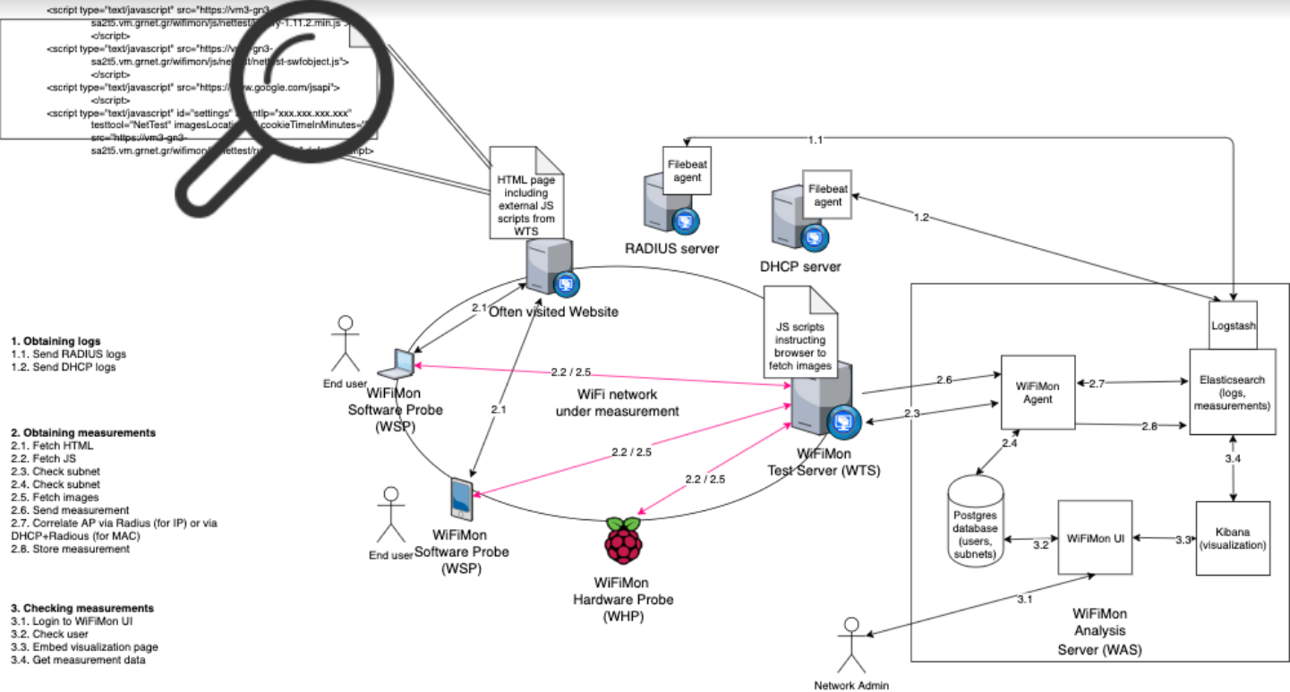
WiFiMon – Overall Architecture
WiFiMon Components:
- WiFiMon Software Probe (WSP) - WiFiMon Test Server (WTS)
- WiFiMon Hardware Probe (WHP) - WiFiMon Analysis Server (WAS)
6
Notes:
The aim of our approach is to record network performance measurements by using collected raw data (data source) on WiFi and to visualize them. ==========
Temporary Data – Raw data from the data source
Persistent Data – Correlated data
==========
Only correlated data will be stored and analysed
Mobility prediction and focus is possible, so the correlation with the AP helps us to provide a localized statement to the network performance.
==========
The Web-User Interface is the Network Administrators view, about their own data. In our concept use Kibana (for visualization) and Elasticsearch (as a DB).
It is worth mentioning that previous WiFiMon versions used Grafana/InfluxDB and PostGresql

Slide 7
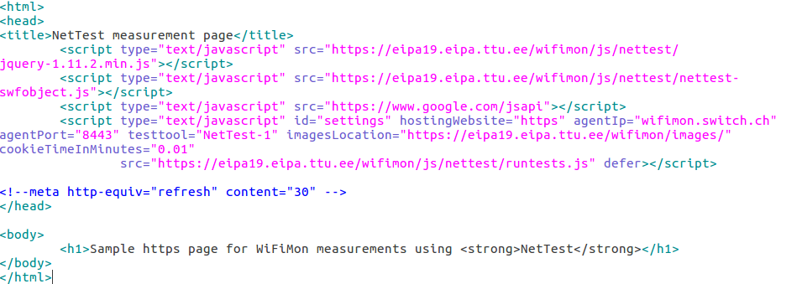
WiFiMon – Data Collection Technology
The end user visits a web page that includes JavaScript code. This triggers measurements.
Available Test Tools: Nettest, Boomerang, Speedtest
User Information
Notes:
To the 1st step. -- web-server JS:
The Domain Name (e.g. www.switch.ch) or the IP of the web-server is needed
The location path of the images is important (location where the NetTest servers is running – Grnet)
Cookie time is essential, as we don’t like to affect the network --- non-invasive
Additional information:
The JS lines should be embedded at a frequently-visited web page (conference program, university website, etc)
The web page can be hosted anywhere without affecting the results
The agent could be installed anywhere, however it is advised to be installed near the conference venue or the university campus. The agent performs the correlations and stores the correlated measurements.
The measurement results are relative to the location of the web server, where the images are hosted.
The website, the WiFiMon agent and the test tool servers can be located at a different physical infrastructure. Only the test tool servers location affect the measurement results!!

Slide 8
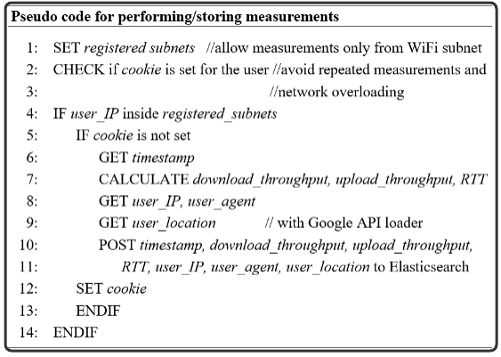
WiFiMon - Performing / Storing measurements
Network Overloading Avoidance:
Measurements accepted only from registered subnets
Cookie: repeated measurements in short time intervals are not permitted
Notes:
To the 2nd step - performing and storing of measurements at the database:
Per configuration:
Sub-Net defined => Measurements only from the sub-nets
Check is Cookie set, YES/NO => Expiration time after the measurements done – 1.5’

Slide 9
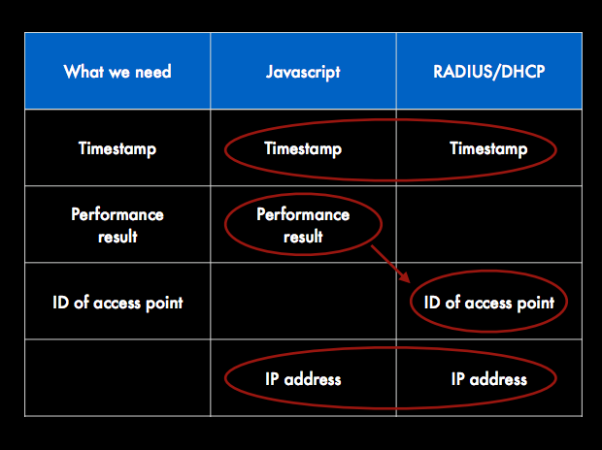
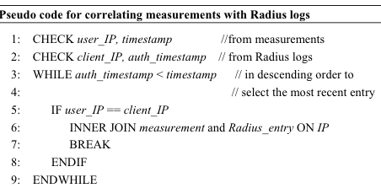
WiFiMon - How we manage/correlate performance data
Notes:
To the 3rd step:
Correlation Performance Data with RADIUS accounting:
Element:
User IP from measurements (javascript)
Client IP from authN/Z

Slide 10
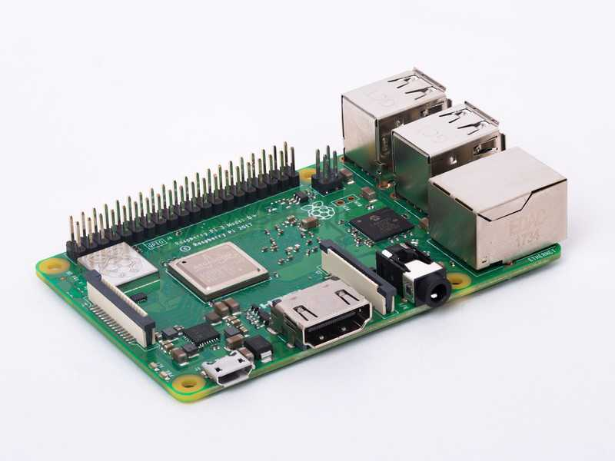
WiFiMon – Hardware Probes
Hardware Probes:
A Raspberry Pi 3 Model B+
A micro SD card with at least 16GB size
WiFiMon Raspberry Pi operating system image
(Size ~ 3.6 GB)

Slide 11
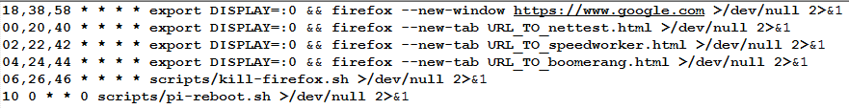
WiFiMon – HW Probe setup steps
Step 1: Write the image to the micro SD card
Follow the instructions at the official Raspberry Pi. Skip the "Download the image" step and use the WiFiMon Raspberry Pi operating system image instead.
Step 2: Start the RPi
Insert the microSD in the RPi
Plug the USB keyboard and USB mouse
Connect the monitor cable to the Pi's HDMI port
Plug the power supply into a socket and connect it to the micro USB power port
The Pi will boot up into a graphical desktop
Step 3: Configure the RPi
Connect to the wireless network you want to measure.
Set which tests will be executed and how often
A simple crontab (20-minute measurements):

Slide 12
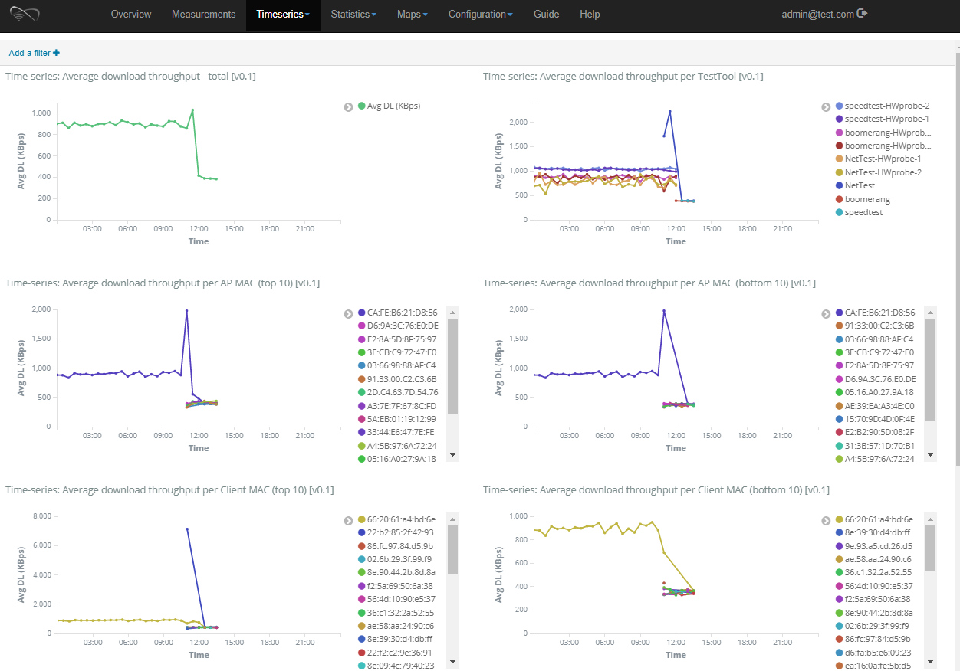
WiFiMon - Web-UI (Timeseries Tab)

Slide 13
WiFiMon Pilot @ TNC19: Available Equipment
5 Raspberry PI 3 Model B+, 64-bit quad-core ARMv8 CPU, 2.4 & 5 GHz, 802.11b/g/n/ac Wireless LAN, Bluetooth 4.2 & BLE
Laptops & Smartphones of WiFiMon team members
Why not TNC19 participants?
GDPR issues
WiFiMon was late to include its purposes in TNC19 privacy notice
Definitely in the future

Slide 14
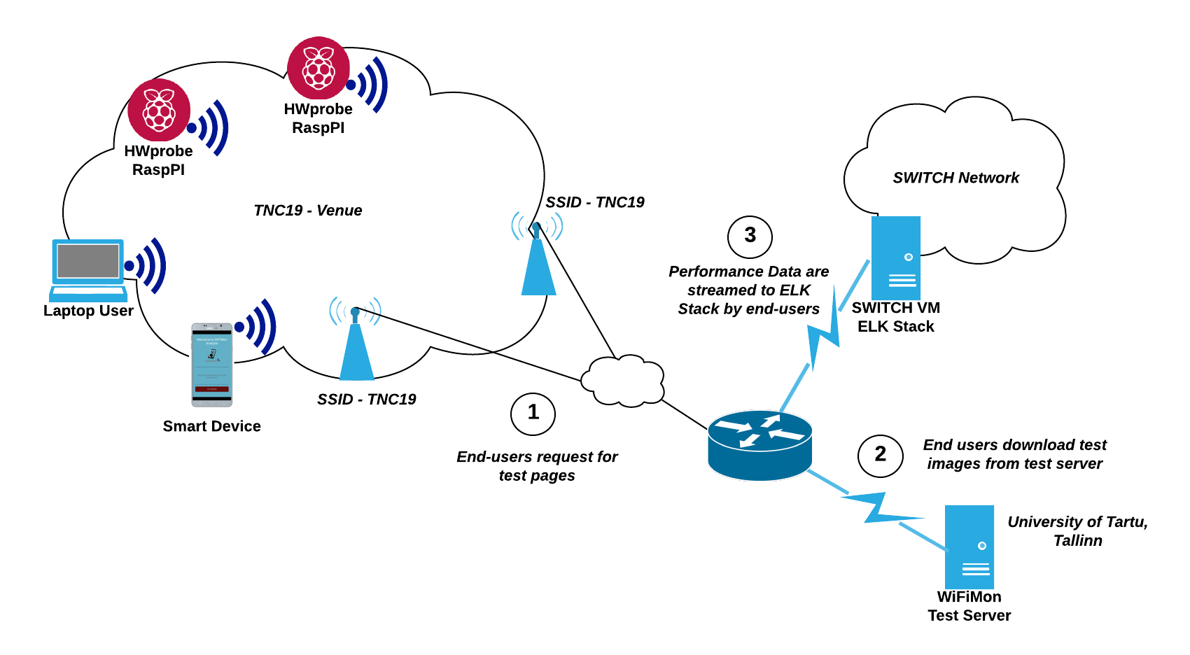
TNC19 Testbed Overview

Slide 15
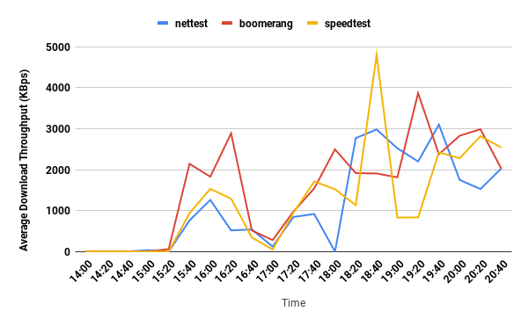
Average Download Throughput in Main Room,
Monday (14.00 - 21.00), including all test tools
Too many lines!
Problem reaching useful conclusions
Infrequent Measurements!
Intervals of 20 minutes are not sufficient

Slide 16
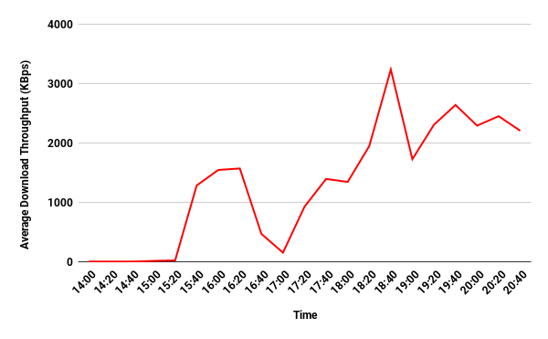
Average Download Throughput in Main Room,
Monday (14.00 - 21.00), Test tools average
WiFi problematic during lightning talks (14.00 - 15.20)
WiFi OK in the afternoon when lots of people have left the venue
Worse throughput during the opening reception (17.00)
WiFi OK in the evening

Slide 17
Feedback from TNC19 & 6th SIG-PMV Meeting Audience
Probing period of deterministic measurements should be decreased. In TNC19 pilot it was 20 minutes.
Charts demonstrating more than a single line, e.g. three lines corresponding to the measurements of all the available test tools, obstruct the audience from reaching quick and useful conclusions.
WiFiMon dashboard should become GDPR compliant.
Work needs to be done on RADIUS logs privacy.
WiFiMon Analysis Server & WiFiMon Test Server installation should be automated.
Additional information should be extracted from Hardware Probes, e.g. signal strength to detect Internet connection problems.

Slide 18
Software Revisions
Migration from the soon to be deprecated Elasticsearch Transport Client to the novel Java High Level REST Client.
Migration from Spring Boot 1.4.2. version to Spring Boot 2.1.2 version.
Migration from ELK stack version 5.6.2 to version 6.8.3

Slide 19

Feedback Integration – Frequent Probing Periods
Each test tool performs a measurement every 5 minutes.

Slide 20
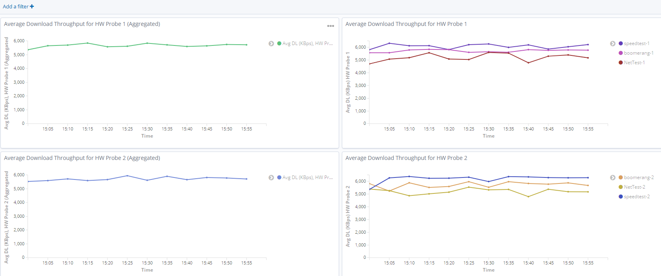
Feedback Integration – HW Probes Visualization
All Hardware Probes in one Tab (up: HW Probe #1, down: HW Probe #2)
Left Chart: Average of all test tools
Right Chart: Measurements from each test tool (Nettest, Boomerang, Speedtest)

Slide 21
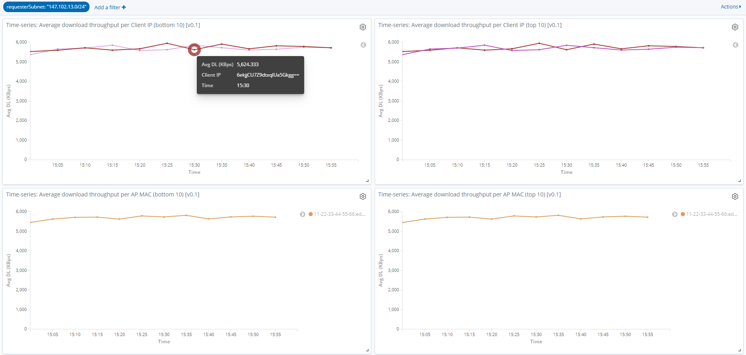
Feedback Integration – Subnets Tab (GDPR Compliance)
Separate Tab for each monitored Subnet.
Client IP & MAC addresses are stored / displayed encrypted with AES-CBC-256 algorithm.
Qualitative Approach: Subnet Administrators do not know which IPs triggered the measurements, but they are interested in the results to learn about their network.

Slide 22
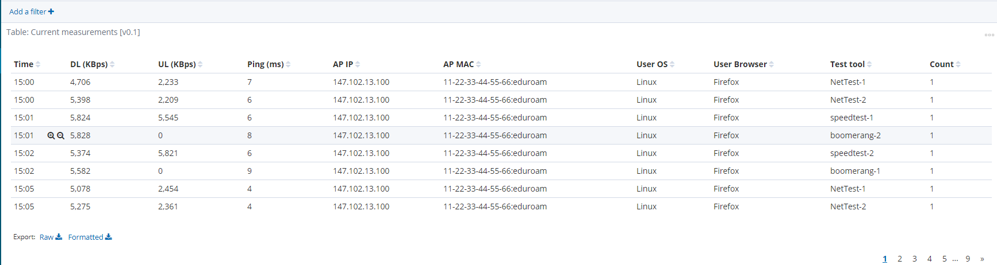
Feedback Integration – Measurements Tab (GDPR Compliance)
Personal Information is removed:
Username
Client IP address
Client MAC address

Slide 23
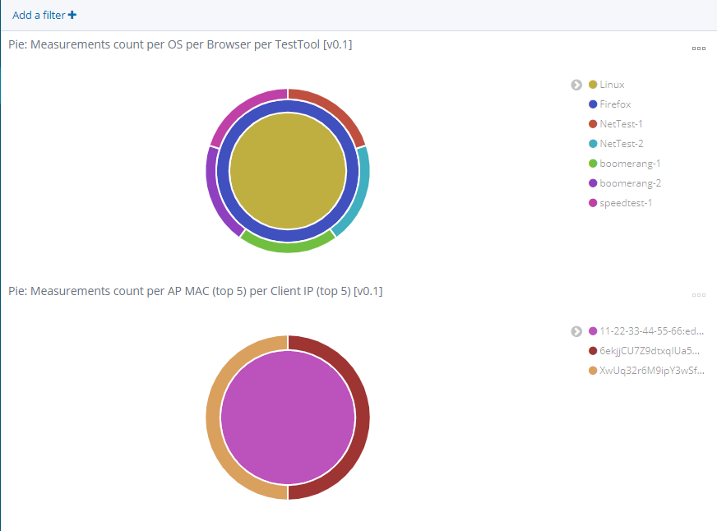
Feedback Integration – Pie Statistics Tab (GDPR Compliance)

Slide 24
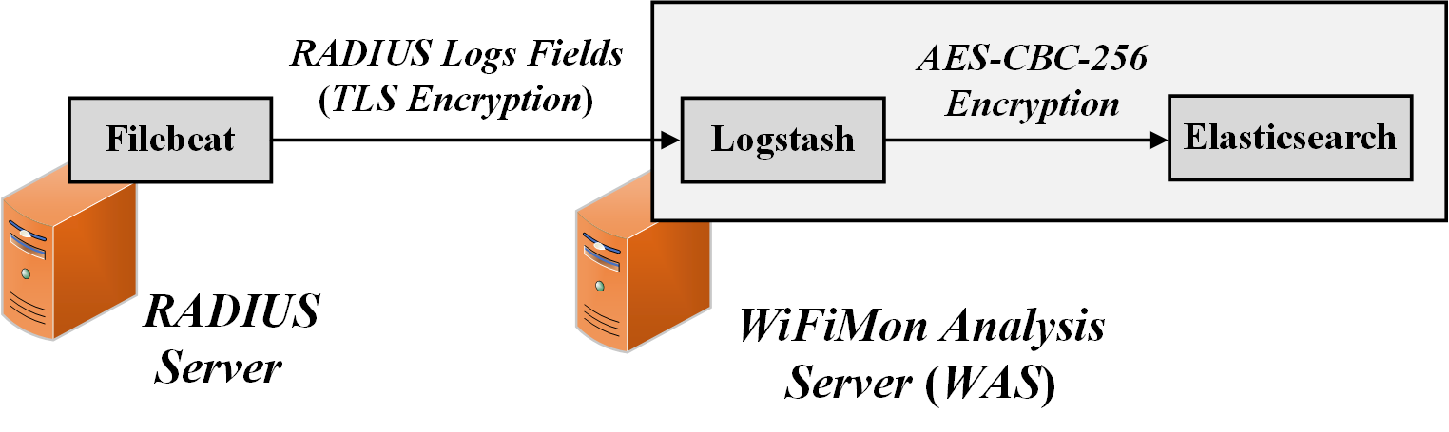
Feedback Integration – RADIUS Logs Privacy
Filebeat: RADIUS logs are streamed encrypted (TLS) to the WiFiMon Agent. Only fields of interest are streamed to reduce total size.
Logstash: RADIUS logs information is encrypted by Logstash using the AES-CBC-256 algorithm. Thus, they are stored encrypted in elasticsearch.

Slide 25
Future Work
Automation of WiFiMon Agent & Test Server Installation.
Integration of new metrics collected from Hardware Probes.
WiFiMon Pilot involving end-users & RADIUS logs correlation
WiFiMon Service planned to be released in 2020
Notes:
As a conclusion, we are able today:
To measure specific parameters, to correlate them
Make a quality statement through the end-user behavior
With Hybrid approach to validate our measurements
In the Future:
To force Data Analysis (Big Data Management)
With Data Analysis to understand better measured data
To design a service

